Slide 1

EDGE
Software Quality Assurance and Testing
Eng. Md. Al Foysal Rabbi
SQA Engineer II, Brain Station 23

Slide 2
How to install Git
Fist of all, download the git exe file from URL https://git-scm.com/install/windows
Subsequently, install the git to local PC
After that, version check from the terminal. The command is <git –version>
Log in to the GitHub account using valid credentials
Create a repo. The repo name is “Edge-software-testing.”

Slide 3
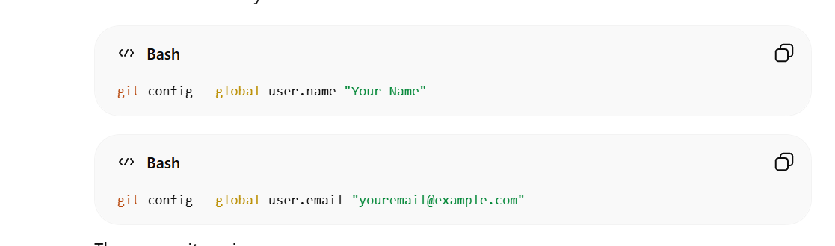
Account Configuration

Slide 4
Short Summery
Install Java (8+)
Download JMeter
Extract JMeter Folder
Run JMeter
(Optional) Add certificate

Slide 5
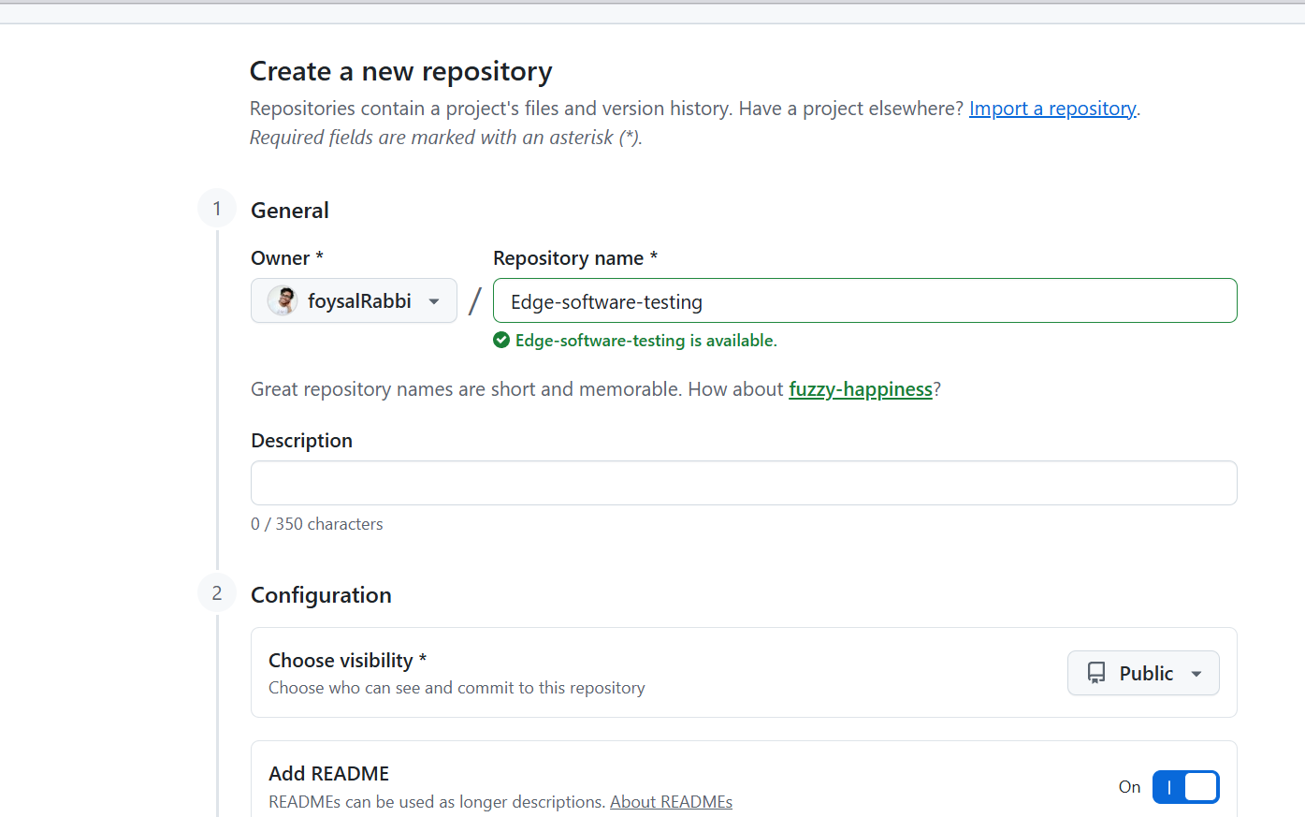

Slide 6
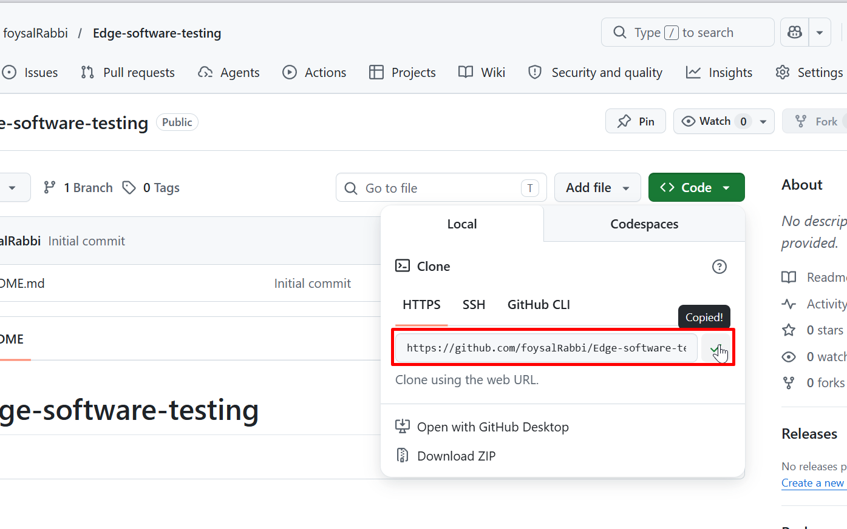
How to clone the git

Slide 7
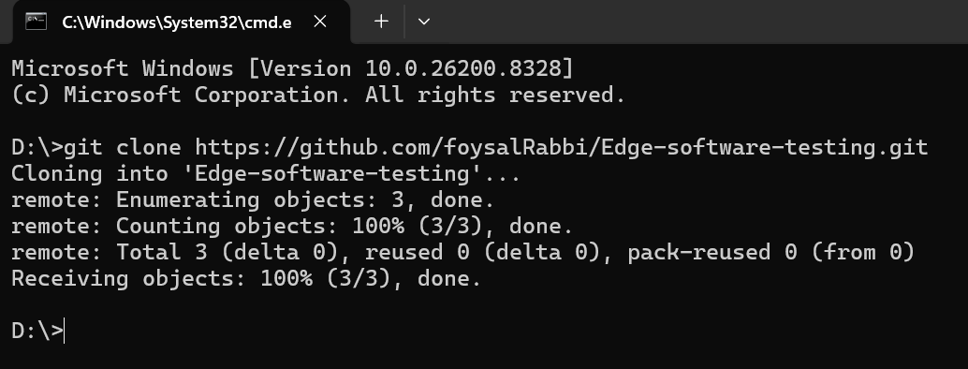
Clone successful message

